Slide 1
Fig Wasp Olfactory gene FaMily OR Evolution
Devin Molnau
Illustration by Rui Tenreiro

Slide 2
outlINE
Introduction
Host-pollinator specificity
Fig wasp life cycle
Insect olfactory families
OR, IR, Gr, CSP and OBP
Objectives
Approach
Work cited
F.Petiolaris

Slide 3
HOST-pollinator Specificity
Weiblen, 2002

Slide 4
BackGround
Fig wasp Life Cycle
Galil & Eisikowitch, 1968

Slide 5
Volatiles
It’s All about the Combination
Common monoterpenes found in plants.
Common sesquiterpenes
Agger, Lopez-Gallego, Hoye, & Schmidt-Dannert, 2008

Slide 6
Olfactory Gene Families
5 olfactory gene families in insects
Odorant receptor (Or)
Gustatory receptor (Gr)
Ionotropic receptor (Ir)
Chemosensory protein (CSP)
Odorant Binding Proteins (OBP)
Fig Wasp
Wasp Model
Bee Model
Ant Model
Human Louse
Xiao et al., 2013
Notes:
C. solmsi pollinates old world fig Ficus hispida and dioecious.

Slide 7
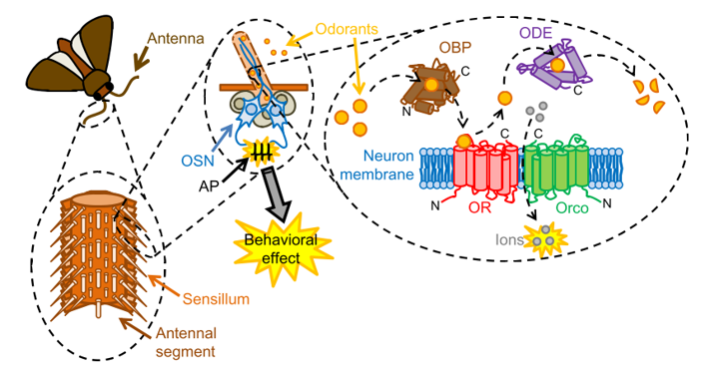
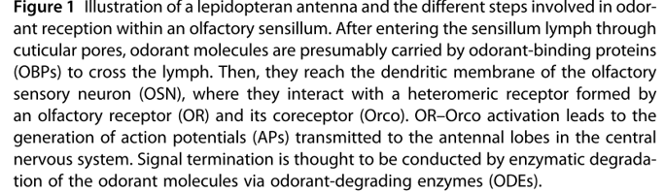
OverVIew
Extracellular
Intracellular
Montagné et al, 2015

Slide 8
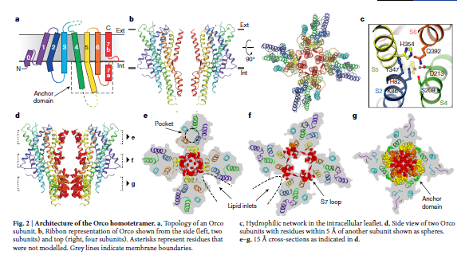
(Butterwick et al., 2018)
Notes:
What OR recognizes: aromatics, terpenes, fatty acid derivatives, alcohols, esters
What an OR looks like: 7 transmembrane domains, intracellular N terminus and extracellular C terminus
What it forms: ligand gated cation channel

Slide 9
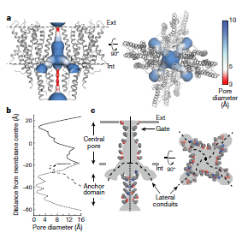
(Butterwick et al., 2018)

Slide 10
Approach
Identify Olfactory genes and build trees
Currently: Verify that we can match the literature
Zhou et al. 2012
Pull from: Apis mellifera (Western honey bee), Camponotus floridanus (ant), Nasonia vitripennis (jewel wasp), Ceratosolen solmsi (Old World fig wasp), Trichogramma pretiosum(parasitic wasp), Copidosoma floridanus (parasitic wasp)
msa→ MUSCLE
Maximum likelihood → RAxML
Model LG4X
100 bootstrap iterations
Visualizing the tree → R
Notes:
LG4X→ 4 substitution matrices that are distribution free for site rates

Slide 11
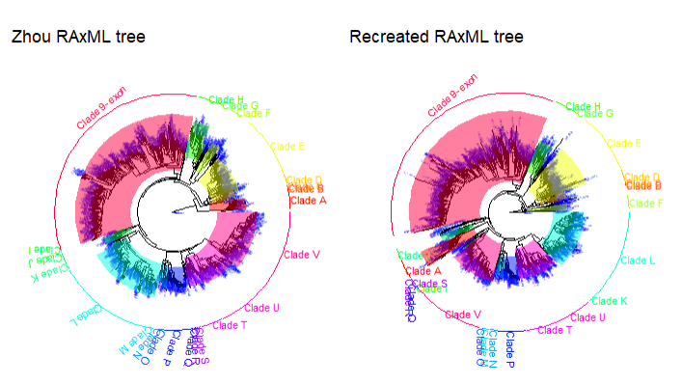
Figure 1: Recreating the reference hymenopteran odorant receptor tree from Zhou et al(Zhou et al., 2012b). Tree of odorant receptors built using MUSCLE and RAxML, bootstrap iteration 100 times and LG4X as a model. The trees are colors according to the clades described in the Zhou paper. The phylogeny includes all known odorant receptors sequences from reference hymenopteran species: from Apis mellifera (western honey bee), Nasonia vitripennis (non-fig-related parasitic wasp), Camponotus floridanus (Florida Carpenter ant), Harpegnathos saltator (Indian jumping ant), Linepithema humile (argentine ant), and Pogonomyrmex barbatus (harvester ant)(H. M. Robertson et al., 2010; Hugh M Robertson & Wanner, 2006; C. D. Smith et al., 2011; C. R. Smith et al., 2011; Zhou et al., 2012a).

Slide 12
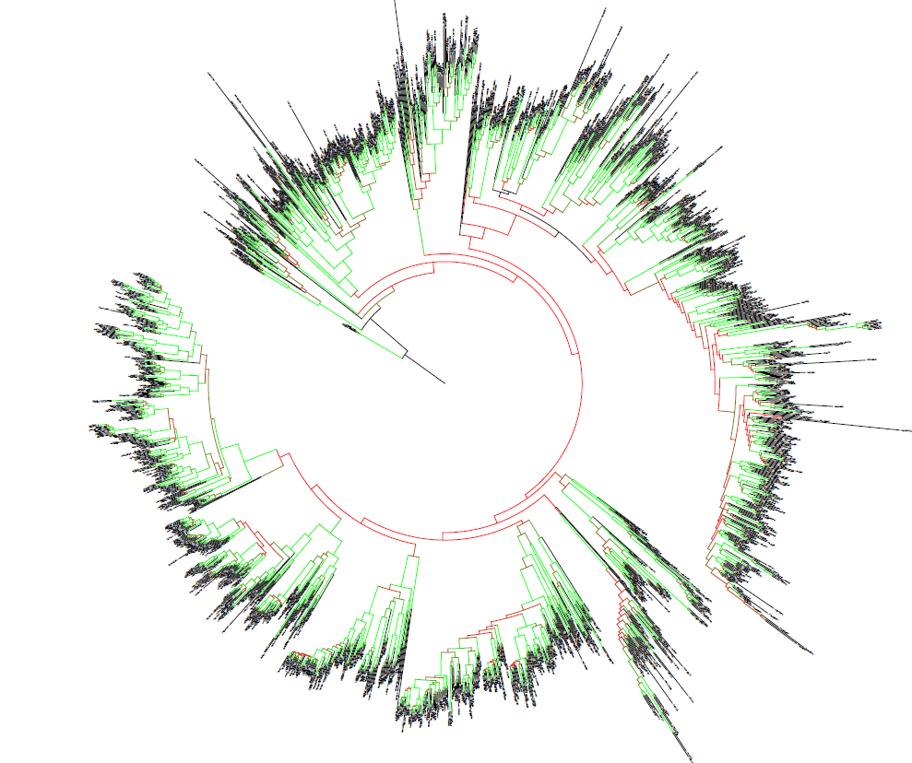

Slide 13
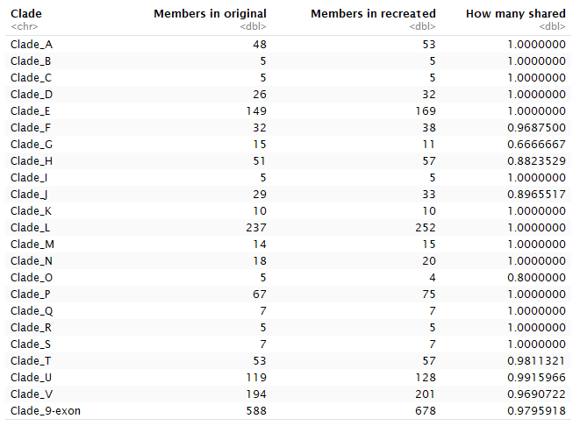

Slide 14
Finding OR Genes
First Attempt→ using genome
Assembled and trimmed using platanus
Fragmented genes→ introns
Second Attempt → transcriptomes
In theory no introns, unless pre-mRNA

Slide 15
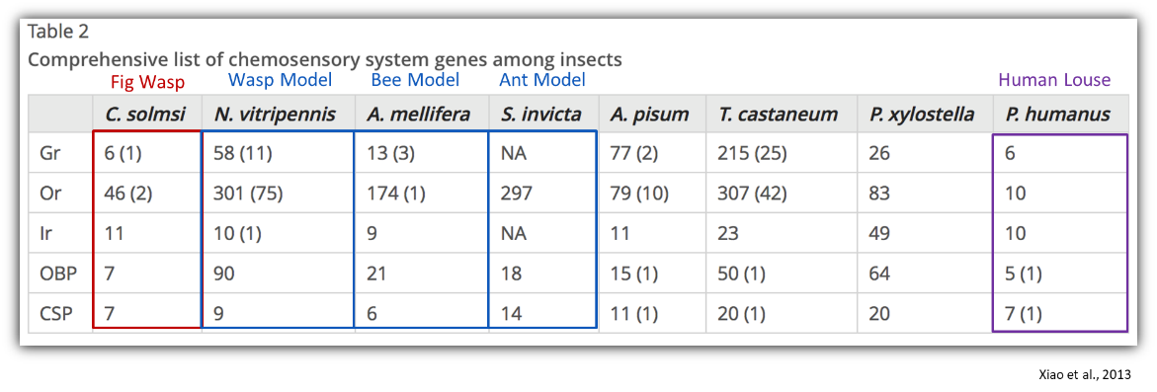
Finding the OR Genes
BLASTX
Odorant Receptors in the fig wasps of Ficus petiolaris
Pegoscapus | Aepocerus | Het1 | Het2 | Idarnes SO1 | Idarnes SO2 | Idarnes LO1 | Physothorax
8 | 13 | 13 | 21 | 35 | 9 | 39 | 18
Table 1: Table of identified odorant receptor protein sequences from transcriptomes in pollinators and non-pollinators in the Ficus petiolaris system. First pass

Slide 16
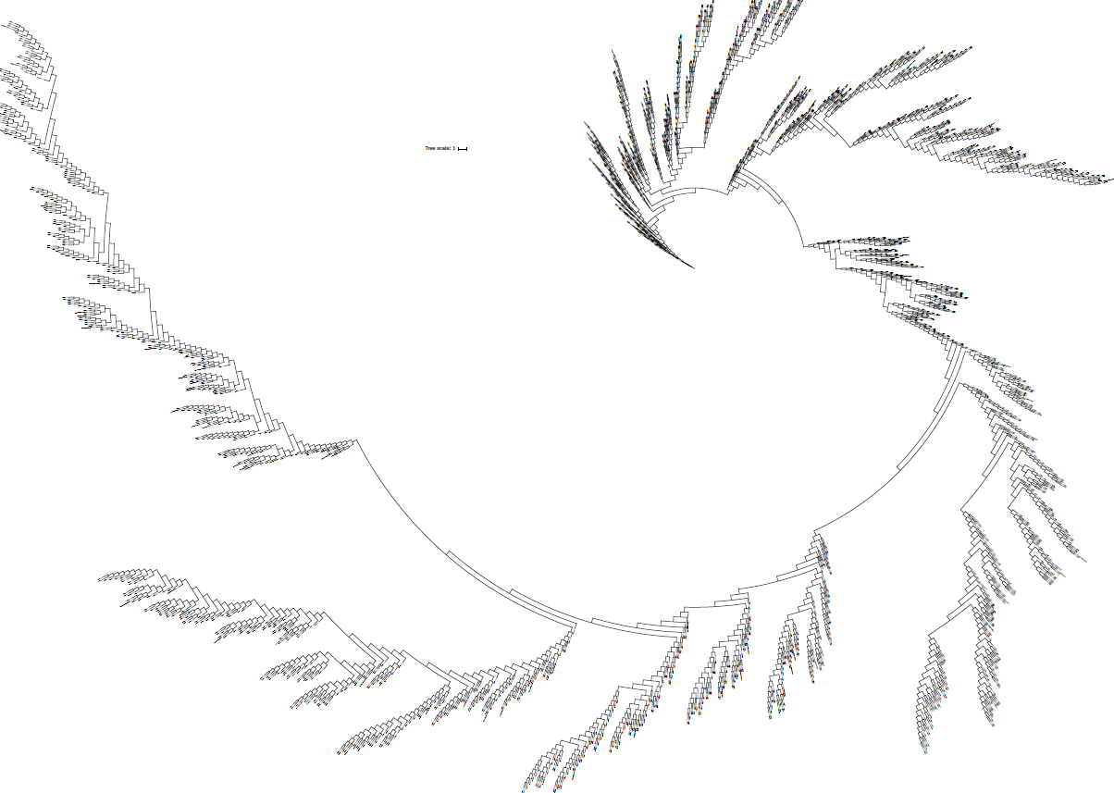

Slide 17
Issues
Genome still too fragemented
MrBayes doesn’t like protein Z
RevBayes→ does this take proteins?
LG4X takes forever
Running for 3 weeks on speedy…

Slide 18
FutURE Work
Run maximum likelihood longer
Bayesian method that takes in protein
Compare to maximum likelihood
Introduce a partitioned model to maximum likelihood model
More thorough searching for genes
Iterative passes
HMMER

Slide 19
Work cited
Illustration: http://www.newyorker.com/tech/elements/love-the-fig
Agger, S. a, Lopez-Gallego, F., Hoye, T. R., & Schmidt-Dannert, C. (2008). Identification of sesquiterpene synthases from Nostoc punctiforme PCC 73102 and Nostoc sp. strain PCC 7120.
Bergstrom, C. T., & Lachmann, M. (2003). The Red King effect: When the slowest runner wins the coevolutionary race. Proceedings of the National Academy of Sciences, 100(2), 593–598. https://doi.org/10.1073/pnas.0134966100
Engsontia, P., Sangket, U., Chotigeat, W., & Satasook, C. (2014). Molecular evolution of the odorant and gustatory receptor genes in lepidopteran insects: Implications for their adaptation and speciation. Journal of Molecular Evolution, 79(1–2), 21–39. https://doi.org/10.1007/s00239-014-9633-0
Galil, J., & Eisikowitch, D. (1968). On the Pollination Ecology of Ficus Sycomorus in East Africa. Ecology, 49(2), 259–269. https://doi.org/10.2307/1934454
Getahun, M. N., Wicher, D., Hansson, B. S., & Olsson, S. B. (2012). Temporal response dynamics of Drosophila olfactory sensory neurons depends on receptor type and response polarity. Frontiers in Cellular Neuroscience, 6(November), 1–11. https://doi.org/10.3389/fncel.2012.00054
Kruse, S., Zhao, R., Smith, D., & Jones, D. (2003). Structure of a specific alcohol-binding site defined by the odorant binding protein LUSH from Drosophila melanogaster. NAt Struct Biol, 10(9), 694–700. https://doi.org/10.1038/nsb960
Lartigue, A., Campanacci, V., Roussel, A., Larsson, A. M., Alwyn Jones, T., Tegoni, M., & Cambillau, C. (2002). X-ray structure and ligand binding study of a moth chemosensory protein. Journal of Biological Chemistry, 277(35), 32094–32098. https://doi.org/10.1074/jbc.M204371200
Leal, W. S. (2013). Odorant Reception in Insects : Roles of Receptors , Binding Proteins , and Degrading Enzymes. Annual Review of Entomology Is, 58, 373–391. https://doi.org/10.1146/annurev-ento-120811-153635
Montagné, N., De Fouchier, A., Newcomb, R. D., & Jacquin-Joly, E. (2015). Advances in the identification and characterization of olfactory receptors in insects. Progress in Molecular Biology and Translational Science, 130, 55–80. https://doi.org/10.1016/bs.pmbts.2014.11.003
Nakagawa, T., Pellegrino, M., Sato, K., Vosshall, L. B., & Touhara, K. (2012). Amino acid residues contributing to function of the heteromeric insect olfactory receptor complex. PLoS ONE, 7(3). https://doi.org/10.1371/journal.pone.0032372
Nason, J. D., Herre, E. A., & Hamrick, J. L. (1998). The breeding structure of a tropical keystone plant resource. Nature, 391(6668), 685–687. https://doi.org/10.1038/35607
Rytz, R., Croset, V., & Benton, R. (2013). Ionotropic Receptors (IRs): Chemosensory ionotropic glutamate receptors in Drosophila and beyond. Insect Biochemistry and Molecular Biology, 43(9), 888–897. https://doi.org/10.1016/j.ibmb.2013.02.007
Sato, K., Pellegrino, M., Nakagawa, T., Nakagawa, T., Vosshall, L. B., & Touhara, K. (2008). Insect olfactory receptors are heteromeric ligand-gated ion channels. Nature, 452(7190), 1002–1006. https://doi.org/10.1038/nature06850
Silbering, A. F., Rytz, R., Grosjean, Y., Abuin, L., Ramdya, P., Jefferis, G. S. X. E., & Benton, R. (2011). Complementary Function and Integrated Wiring of the Evolutionarily Distinct Drosophila Olfactory Subsystems. Journal of Neuroscience, 31(38), 13357–13375. https://doi.org/10.1523/JNEUROSCI.2360-11.2011
Vieira, F. G., & Rozas, J. (2011). Comparative genomics of the odorant-binding and chemosensory protein gene families across the arthropoda: Origin and evolutionary history of the chemosensory system. Genome Biology and Evolution, 3(1), 476–490. https://doi.org/10.1093/gbe/evr033
Weiblen, G. D. (2002). How to be a fig wasp. Annual Review of Entomology, 47, 299–330.
Wicher, D. (2015). Olfactory signaling in insects. Progress in Molecular Biology and Translational Science (1st ed., Vol. 130). Elsevier Inc. https://doi.org/10.1016/bs.pmbts.2014.11.002
Xiao, J.-H., Yue, Z., Jia, L.-Y., Yang, X.-H., Niu, L.-H., Wang, Z., … Huang, D.-W. (2013). Obligate mutualism within a host drives the extreme specialization of a fig wasp genome. Genome Biology. https://doi.org/10.1186/gb-2013-14-12-r141
Zhou, X., Slone, J. D., Rokas, A., Berger, S. L., Liebig, J., Ray, A., … Zwiebel, L. J. (2012). Phylogenetic and Transcriptomic Analysis of Chemosensory Receptors in a Pair of Divergent Ant Species Reveals Sex-Specific Signatures of Odor Coding. PLoS Genetics, 8(8). https://doi.org/10.1371/journal.pgen.1002930
https://i.ytimg.com/vi/4tysZPU9w_c/maxresdefault.jpg

